Slide 1
Implementing an OS for Raspberry Pi 3 in Rust
刘云飞 李维晟 汪若辰 余磊

Slide 2


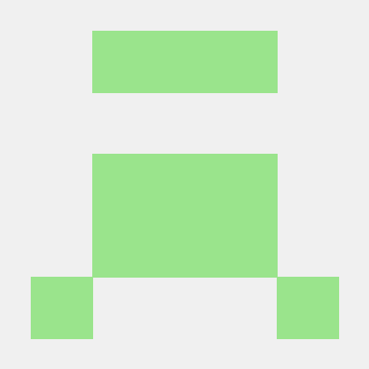
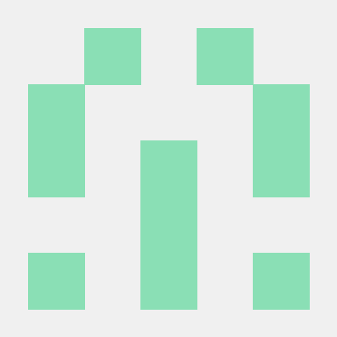
汇报分工
余磊
李维晟
Research
Feasibility
汪若辰
刘云飞
Planning
Progress

Slide 3
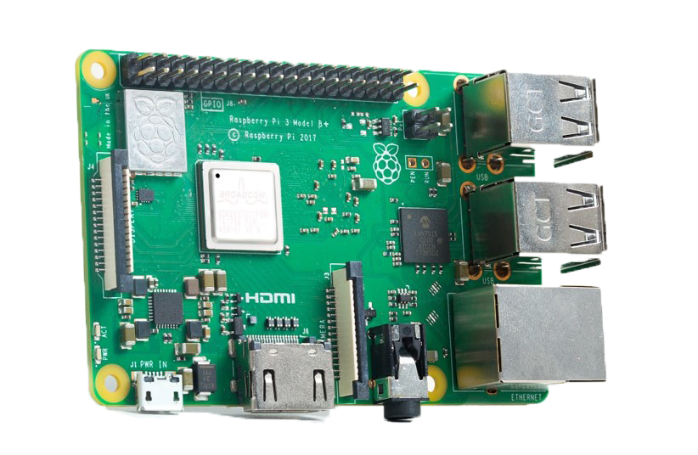

Part 1 Research

Slide 4
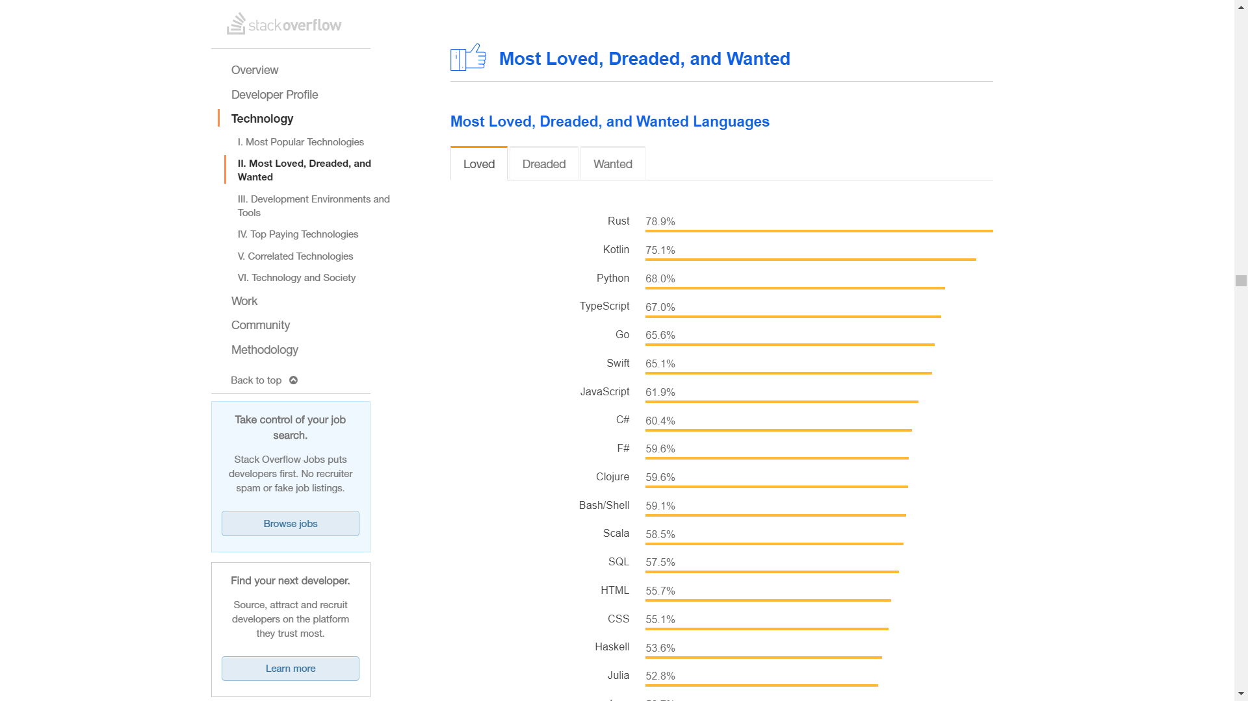

Slide 5
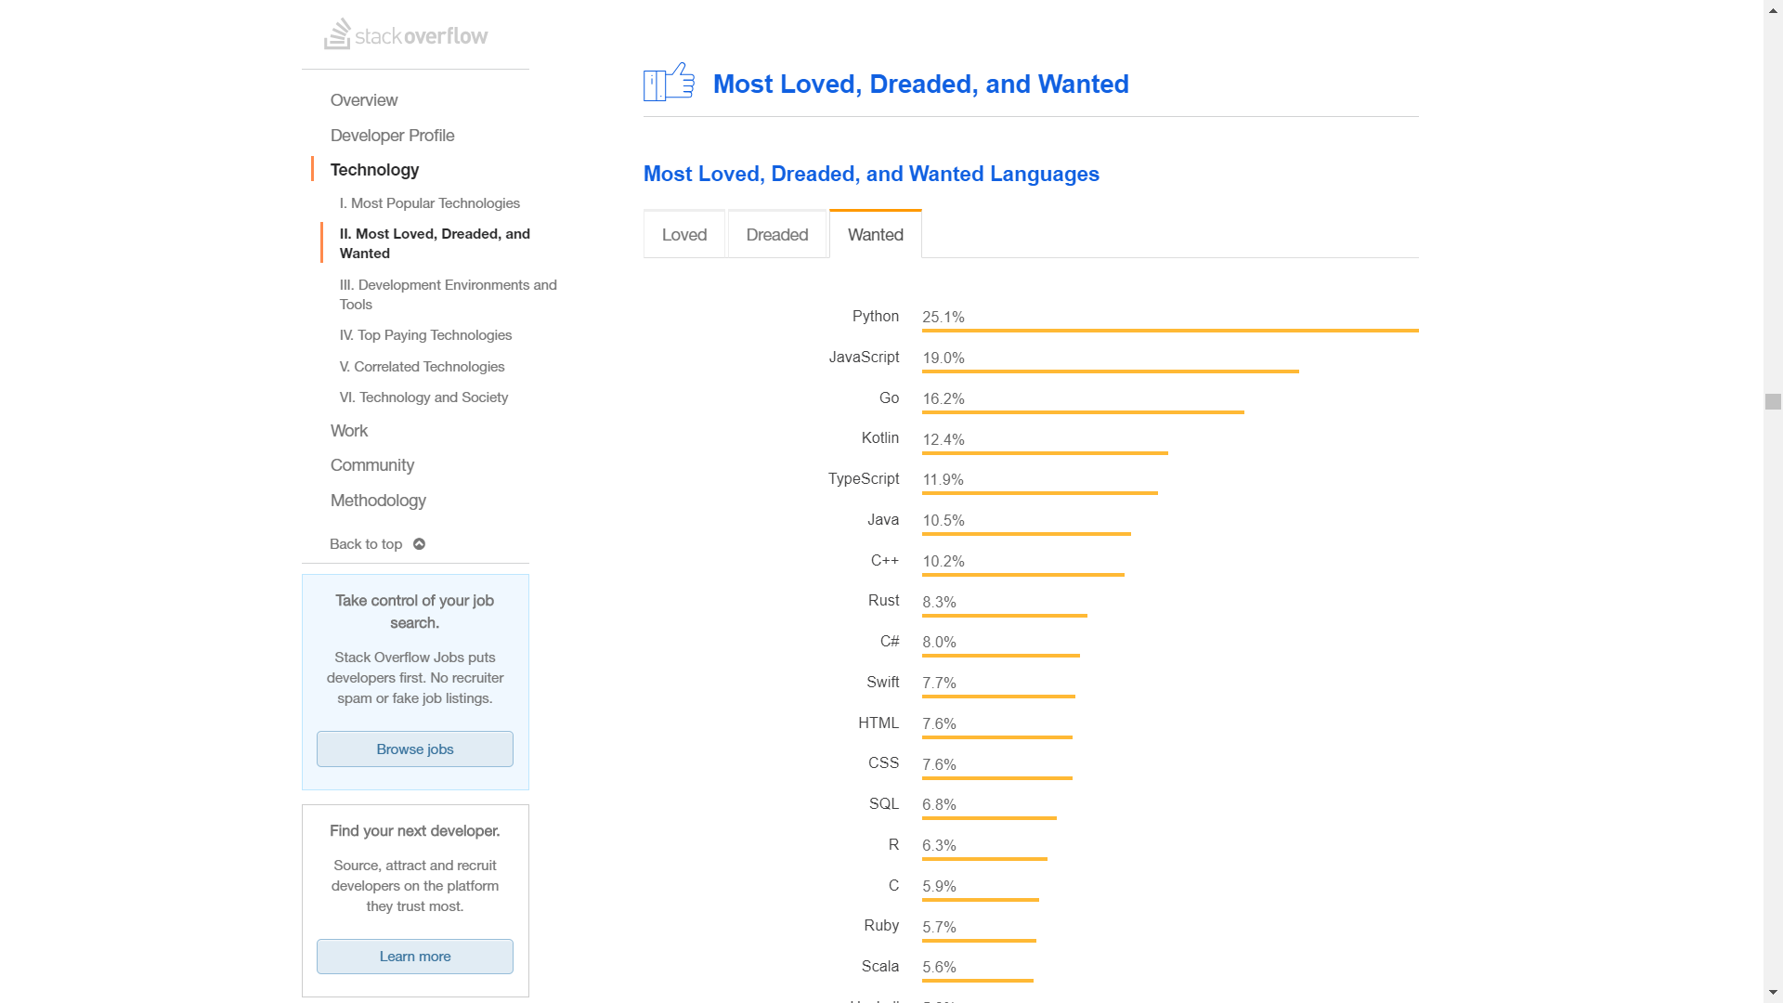

Slide 6


Orbital

Slide 7
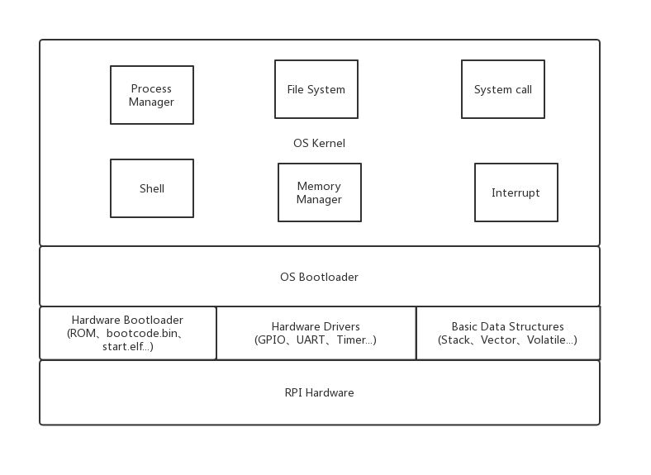
Part 2 Feasibility

Slide 8
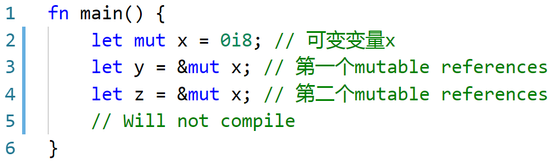
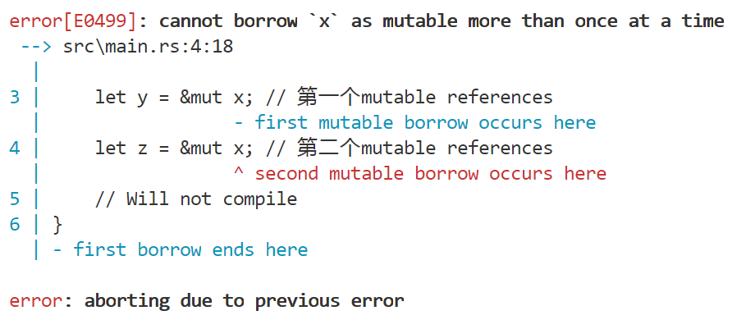
Rust 如何避免数据竞争
Borrowing Rules
a.
b.
Data Race Conditions
a.
b.
c.

Slide 9
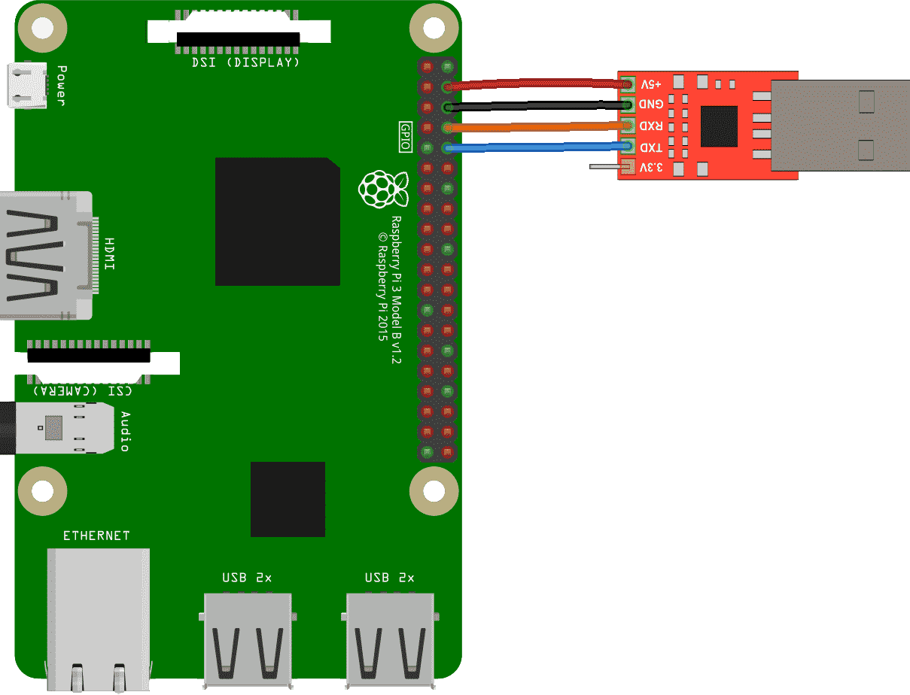
Part 3 Planning
CS140e
Further …
Notes:
计划先跟着 cs140e 做完
优化; 接 HDMI, 键盘 ......
USB 转 TTL 使用 screen

Slide 10
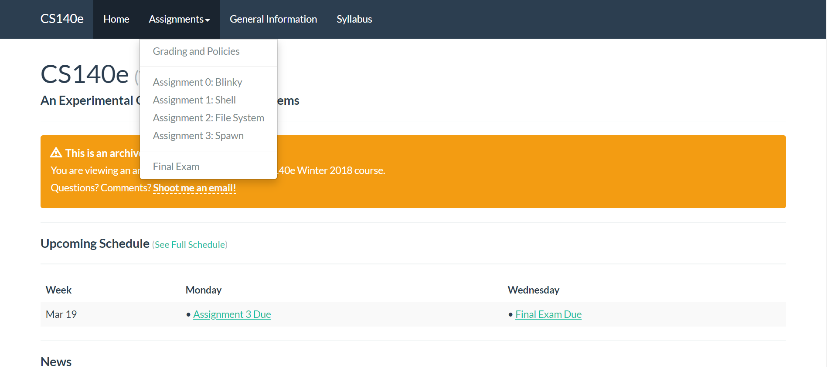
CS140e @ https://cs140e.sergio.bz/
Notes:
0. blinky: 闪灯实验, 熟悉环境
1. shell: 一些工具, 库, 一个 shell (正在做)
2. fs: 内存分配器, FAT32 文件系统
3. spawn: 进程相关

Slide 11
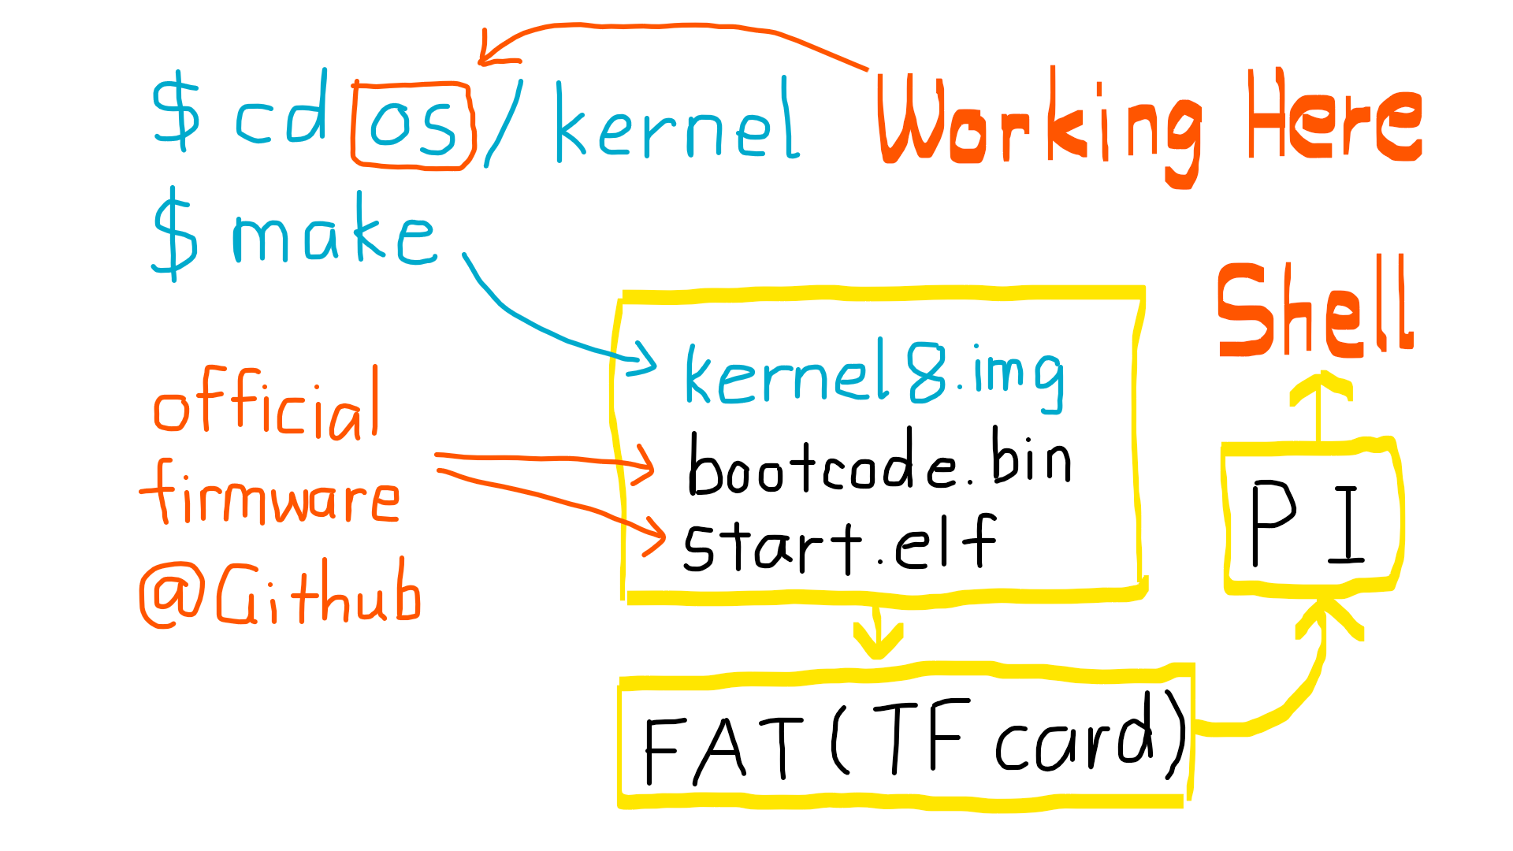
Notes:
https://www.raspberrypi.org/documentation/configuration/config-txt/boot.md
kernel7.img 可用在 Pi 2, Pi 3 上, 如果 Pi 3 上有 kernel8.img, 就会加载 kernel8.img

Slide 12
Part 4 Progress
Assignment 0: Blinky
Assignment 1: Shell
Assignment 2: File System
Assignment 3: Spawn
Further …

Slide 13
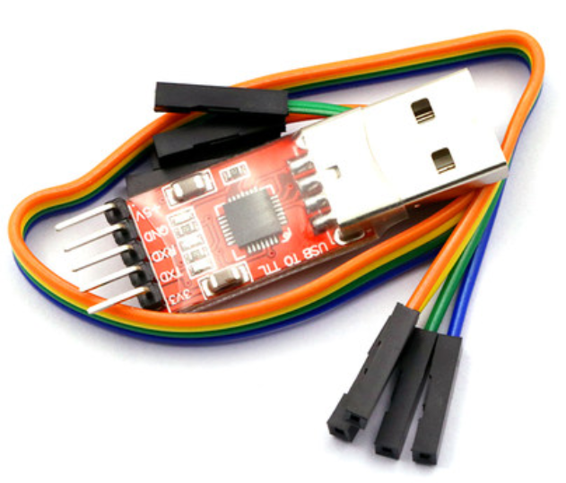
Assignment 0: Blinky
Use USB TTL adapter to communicate with Raspberry Pi.

Slide 14
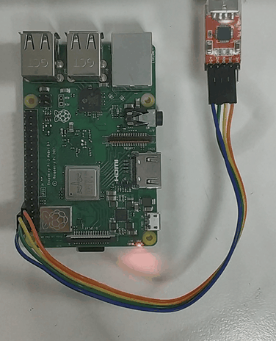
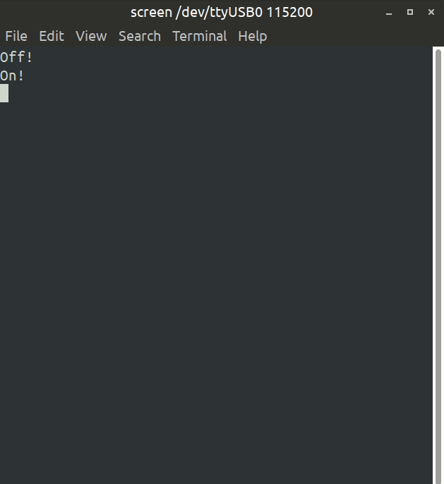
$ sudo screen /dev/ttyUSB0 115200

Slide 15

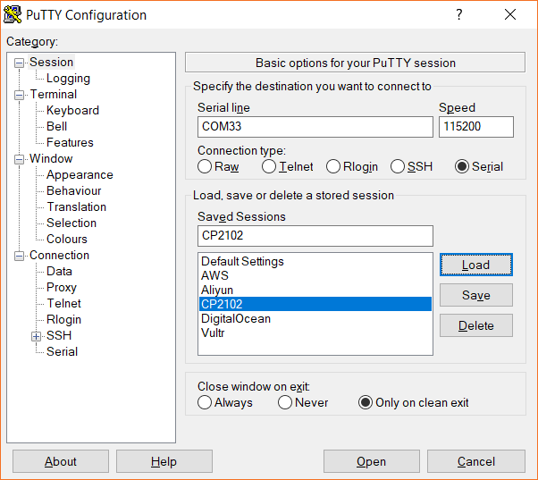
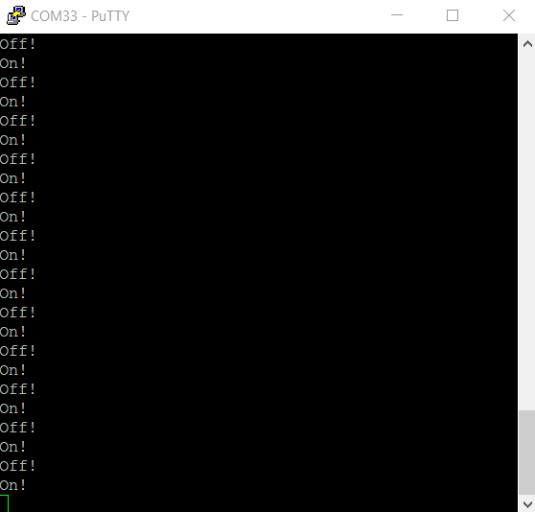
putty.exe COMXX 115200bps

Slide 16

Assignment 1: Shell
StackVec
volatile
xmodem
ttywrite
Timer
GPIO
UART
Shell

Slide 17
Basic structure and interface
StackVec
Volatile type (R, W, R/W, unique)

Slide 18
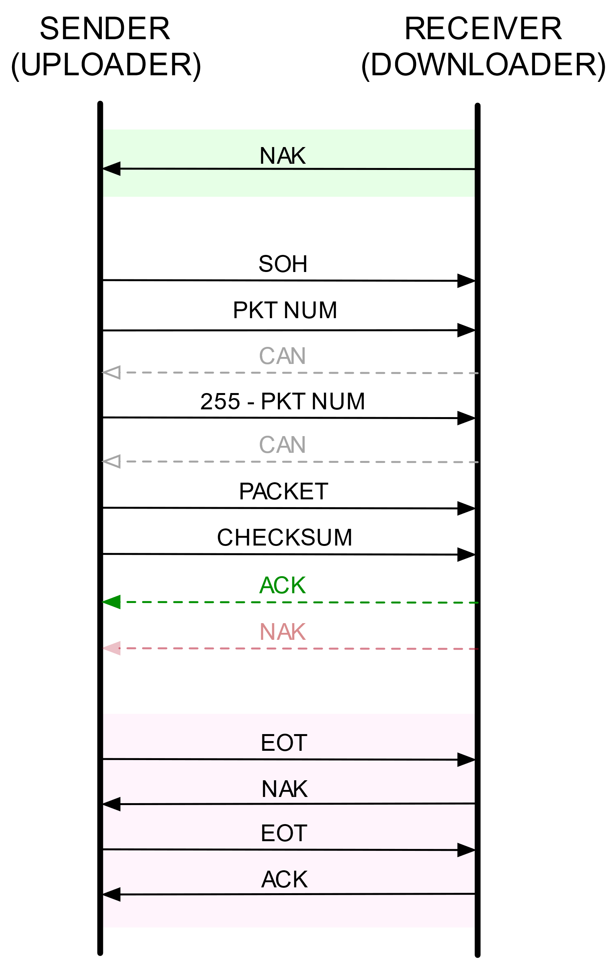
Transmission Method
XMODEM protocol
ttywrite (teletypewriter)

Slide 19
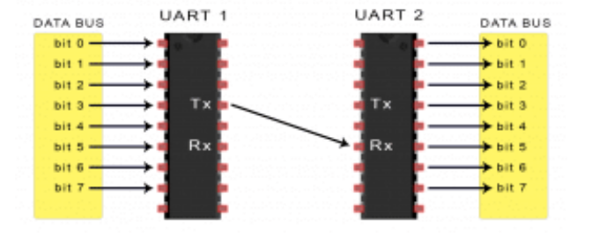
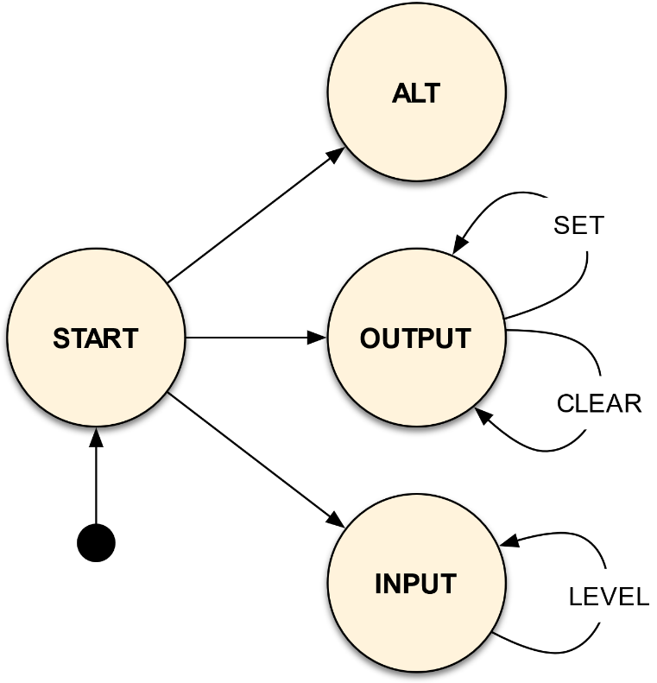
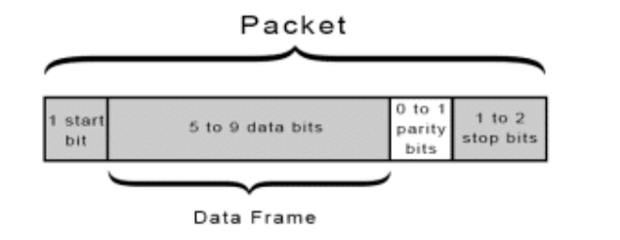
Device Driver
Timer
GPIO
UART

Slide 20
Console and Shell
Coming soon!

Slide 21
Implementing an OS for Raspberry Pi 3 in Rust
Thank You!
刘云飞 李维晟 汪若辰 余磊

